Slide 1
Introduction to Robotics CSE461
Utsha Kumar Roy
BRAC University

Slide 2
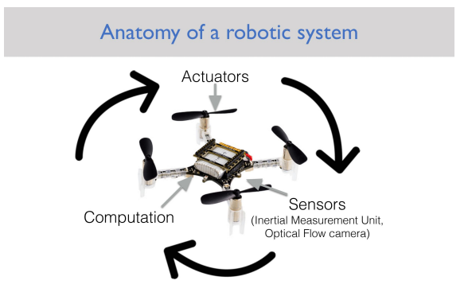

Slide 3
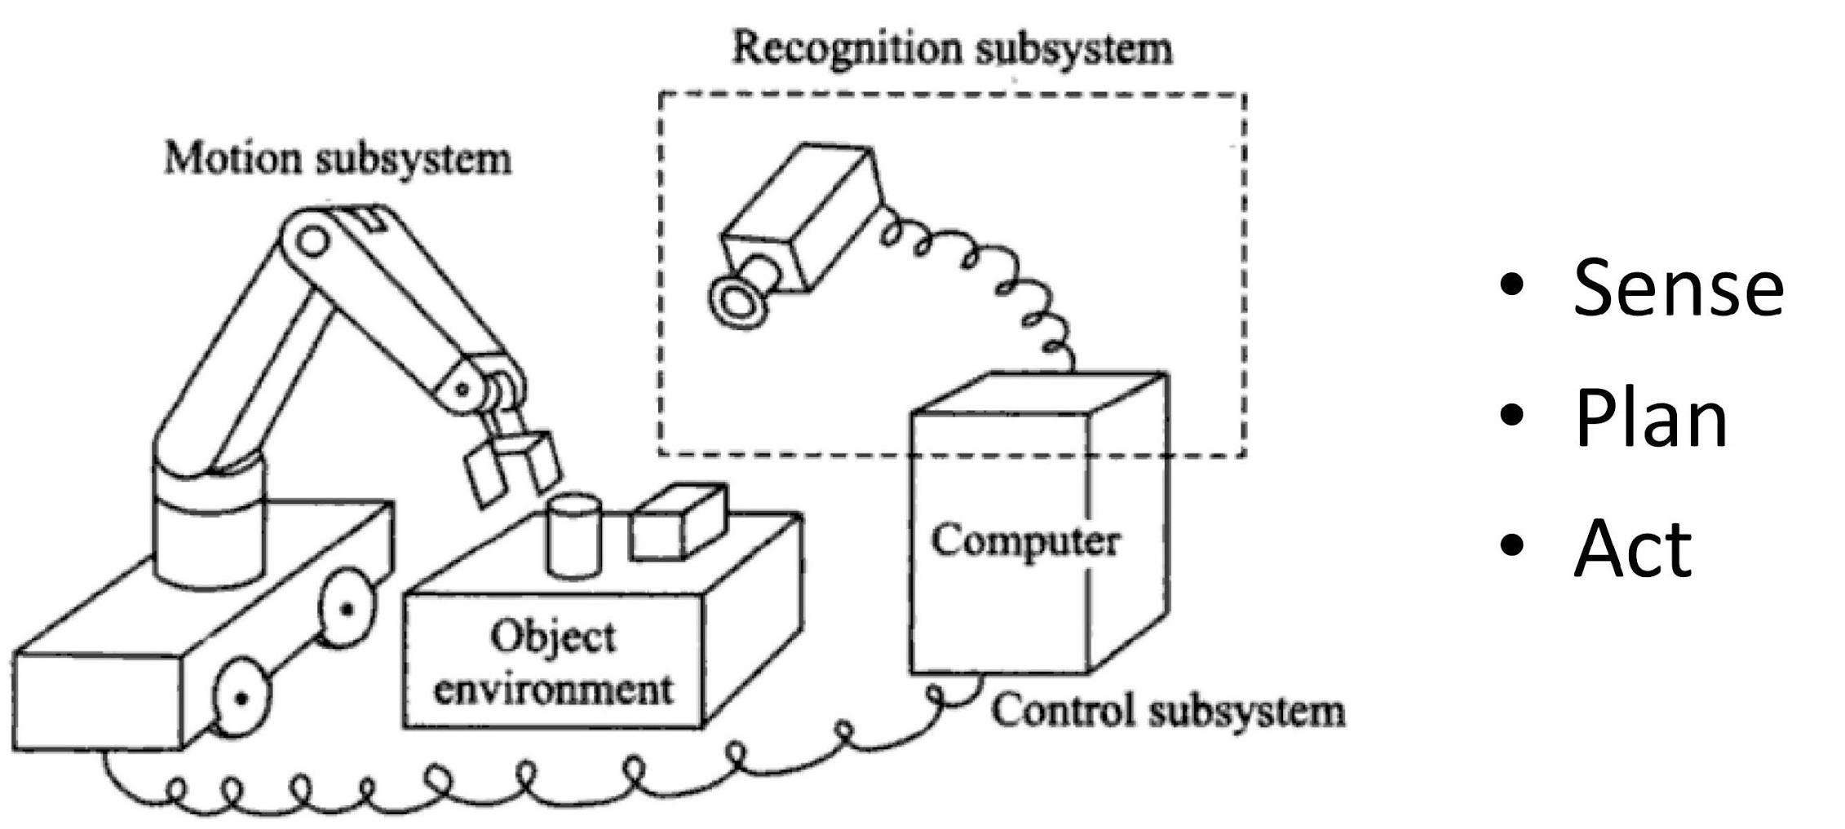
Three primitives of robotics

Slide 4
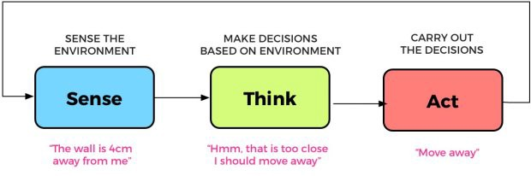
Example

Slide 5
AI Primitives within an Agent
SENSE
PLAN
ACT
LEARN

Slide 6
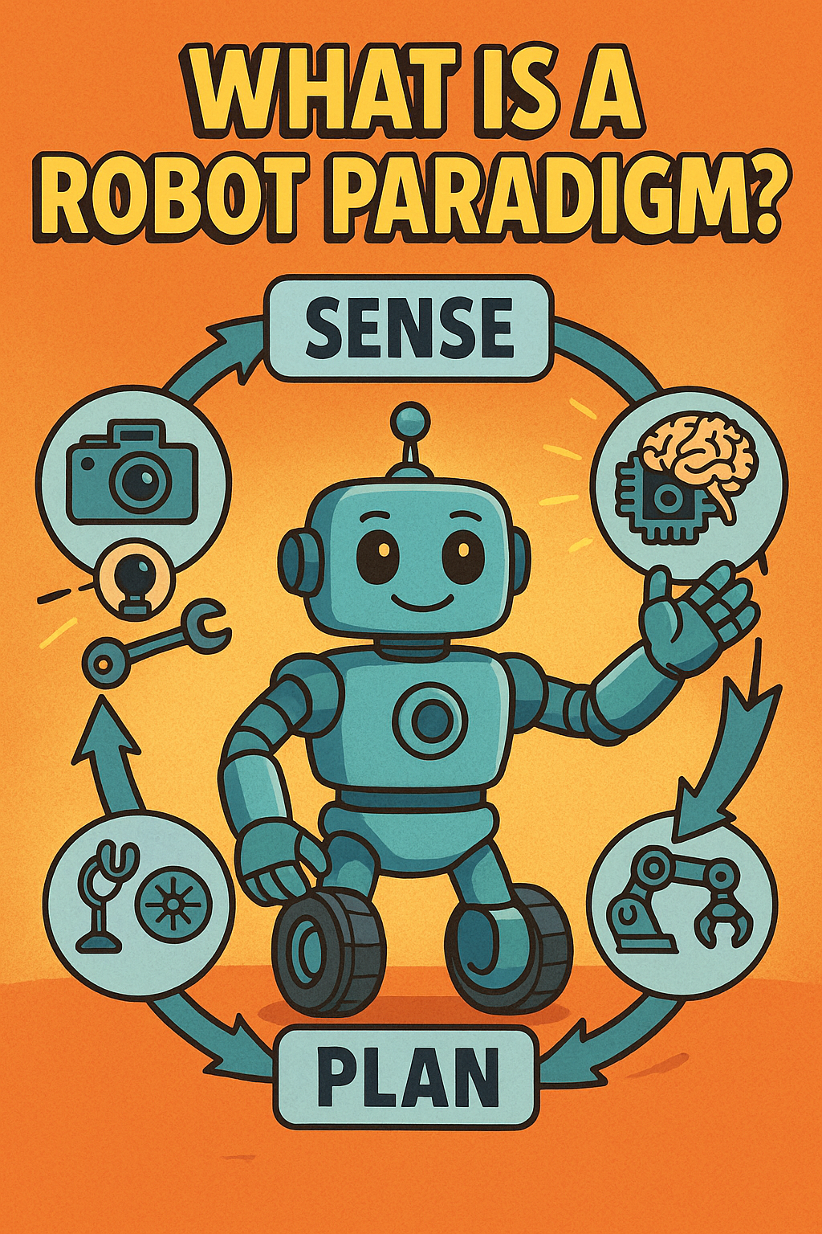

Slide 7
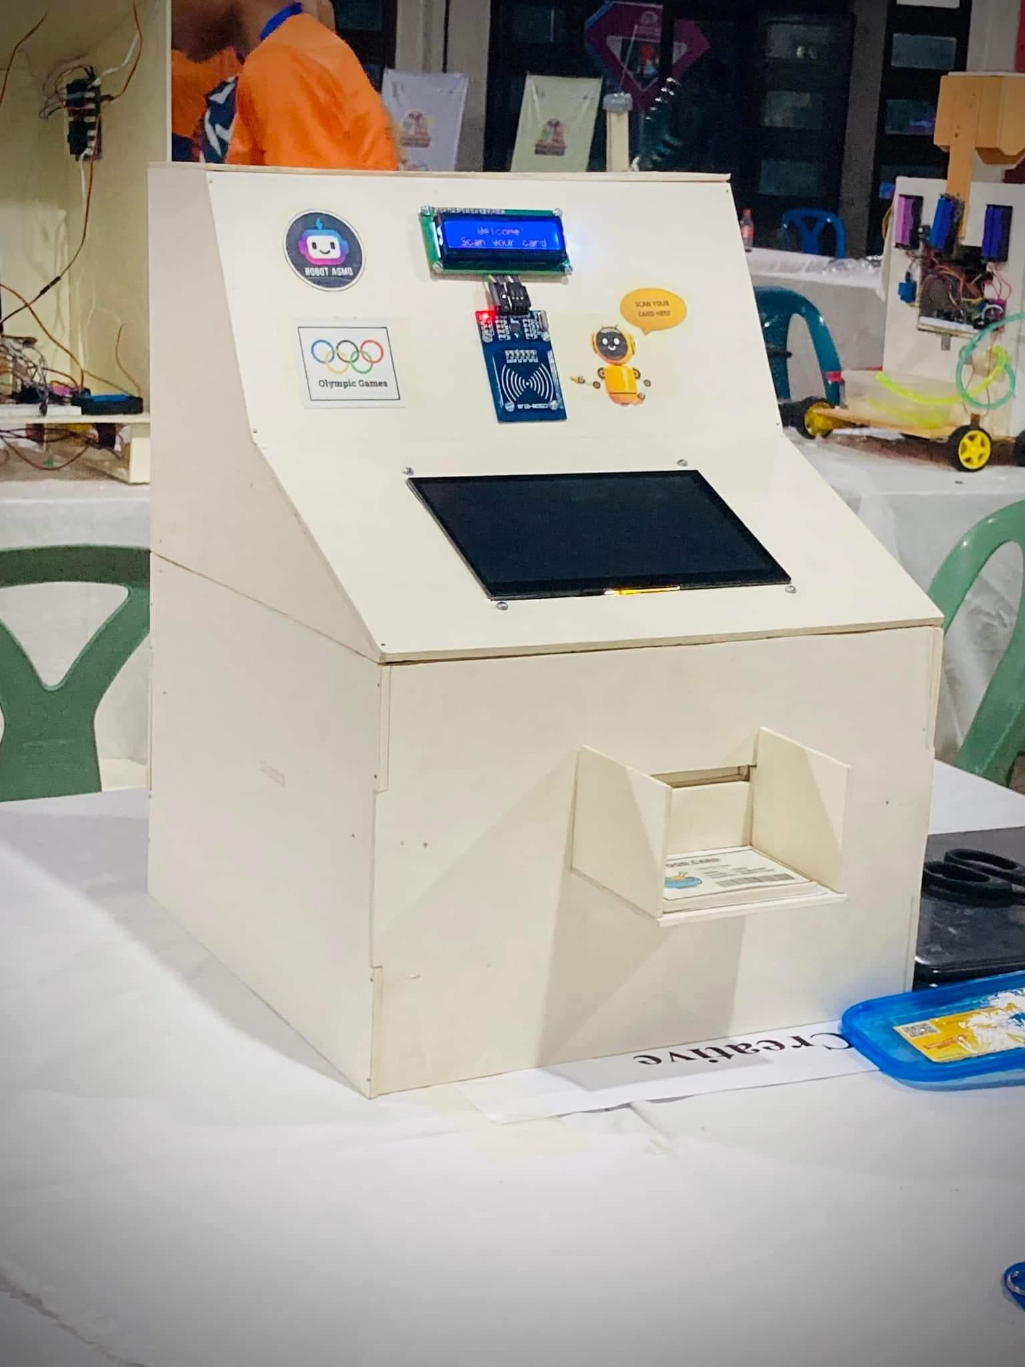

Slide 8
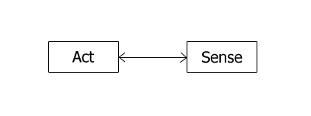
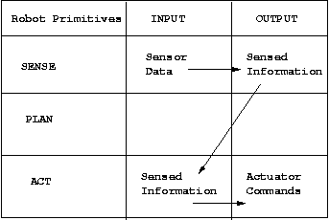
Reactive Paradigm

Slide 9
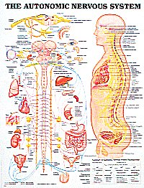
Reactive
SENSE
ACT
PLAN
SENSE
ACT
SENSE
ACT
Users loved it because it worked
AI people loved it, but wanted to put PLAN back in
Control people hated it because couldn’t rigorously prove it worked

Slide 10


Slide 11
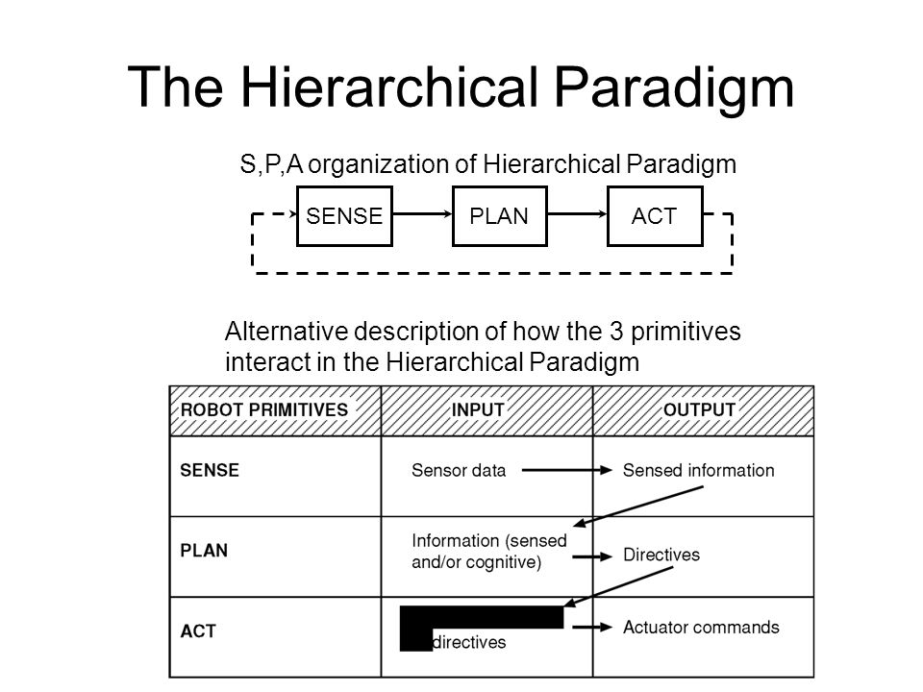

Slide 12
Hierarchical/deliberative paradigm
2
1
SENSE
PLAN
ACT
3
Hierarchical/deliberative paradigm
Control people hated because didn’t “close the loop”
AI people hated because monolithic
Users hated because very slow

Slide 13
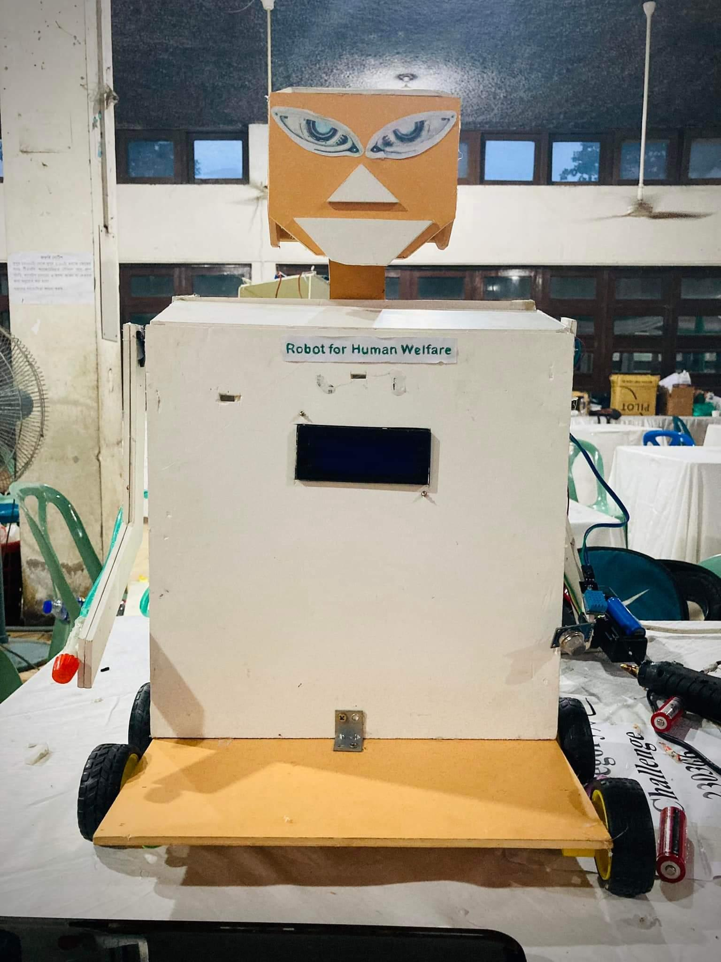

Slide 14
Hybrid deliberative/reactive paradigm
PLAN
SENSE
ACT
SENSE
ACT
SENSE
ACT

Slide 15
Hybrid
PLAN
SENSE
ACT
SENSE
ACT
SENSE
ACT
Control people hated it because AI, but are getting over it
AI people loved it
Users loved it

Slide 16
ROBOTIC PARADIGMS
Hierarchical/deliberative paradigm
The reactive paradigm
Hybrid deliberate/reactive paradigm
A fourth category, not always listed, is “Behavior-Based Control”
https://www.youtube.com/watch?v=dnidauuaWYU

Slide 17
Advantages
Asynchronous processing technique allow to function Independently
Planner can slowly computer next goal while robot can perform reactive task
First reactive updates then global panner for planning
Good software Modularity

Slide 18
Local and Global Model
Reactive for Local control
Deliberative for Global control
However; Robot behavioral management requires to know its current mission, state and environment beside path-planning, map-making, monitoring etc. So, both local and global models are required to be considered for a robot performance.

Slide 19
Hierarchical/deliberative paradigm
The robot operates in a top-down fashion, heavy on planning.
The robot senses the world, plans the next action, acts; at each step the robot explicitly plans the next move.
All the sensing data tends to be gathered into one global world model.

Slide 20
The reactive paradigm
Sense-act type of organization.
The robot has multiple instances of Sense-Act couplings.
Robot take the local sensing data and compute the best action to take independently of what the other processes are doing.
The robot will do a combination of behaviours.

Slide 21
Hybrid deliberate/reactive paradigm
The robot first plans (deliberates) how to best decompose a task into subtasks (also called “mission planning”) and then what are the suitable behaviours to accomplish each subtask.
Then the behaviours starts executing as per the Reactive Paradigm.
Sensing organization is also a mixture of Hierarchical and Reactive styles; sensor data gets routed to each behaviour that needs that sensor, but is also available to the planner for construction of a task-oriented global world model.

Slide 22
How AI Relates to Factory Automation
Deliberative:
Upper level is mission generation & monitoring
But World Modeling & Monitoring is hard (SA)
Lower level is selection of behaviors to accomplish task (implementation) & local monitoring
monitoring
generating
World
model
plan
selecting
implementing
Reactive (fly by wire, inner loop control):
Many concurrent stimulus-response behaviors, strung together with simple scripting
Action is generated by sensed or internal stimulus
No awareness, no monitoring
Models are of the vehicle, not the “larger” world
sense
act
sense
act
sense
act

Slide 23
Lets know, How robots work?

Slide 24


Slide 25
Sub-Systems
Sense/Perception/ Recognition
Plan/Control
Act/Motor Action/Motion
Power
Communication

Slide 26
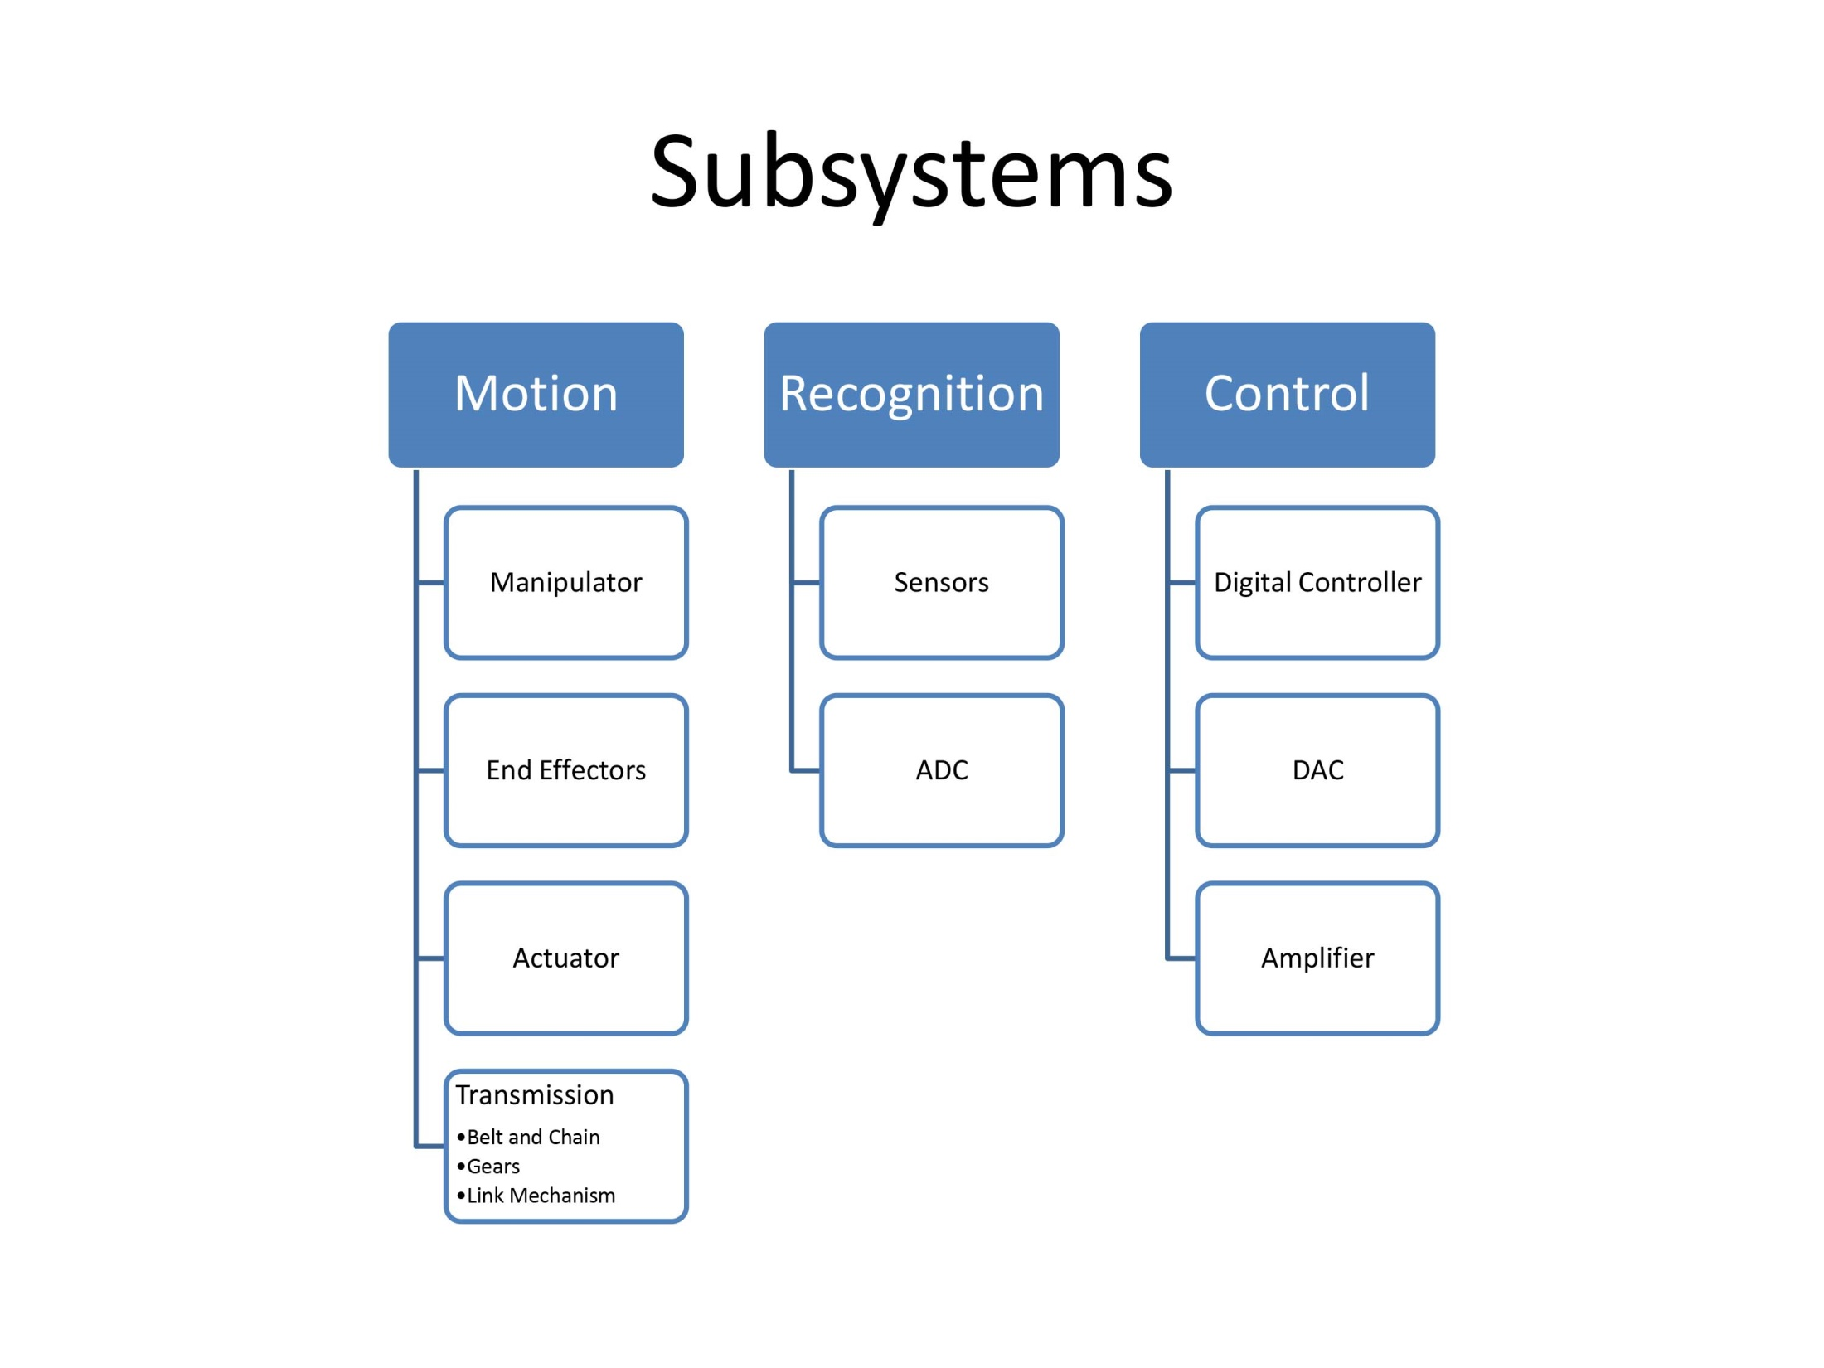

Slide 27
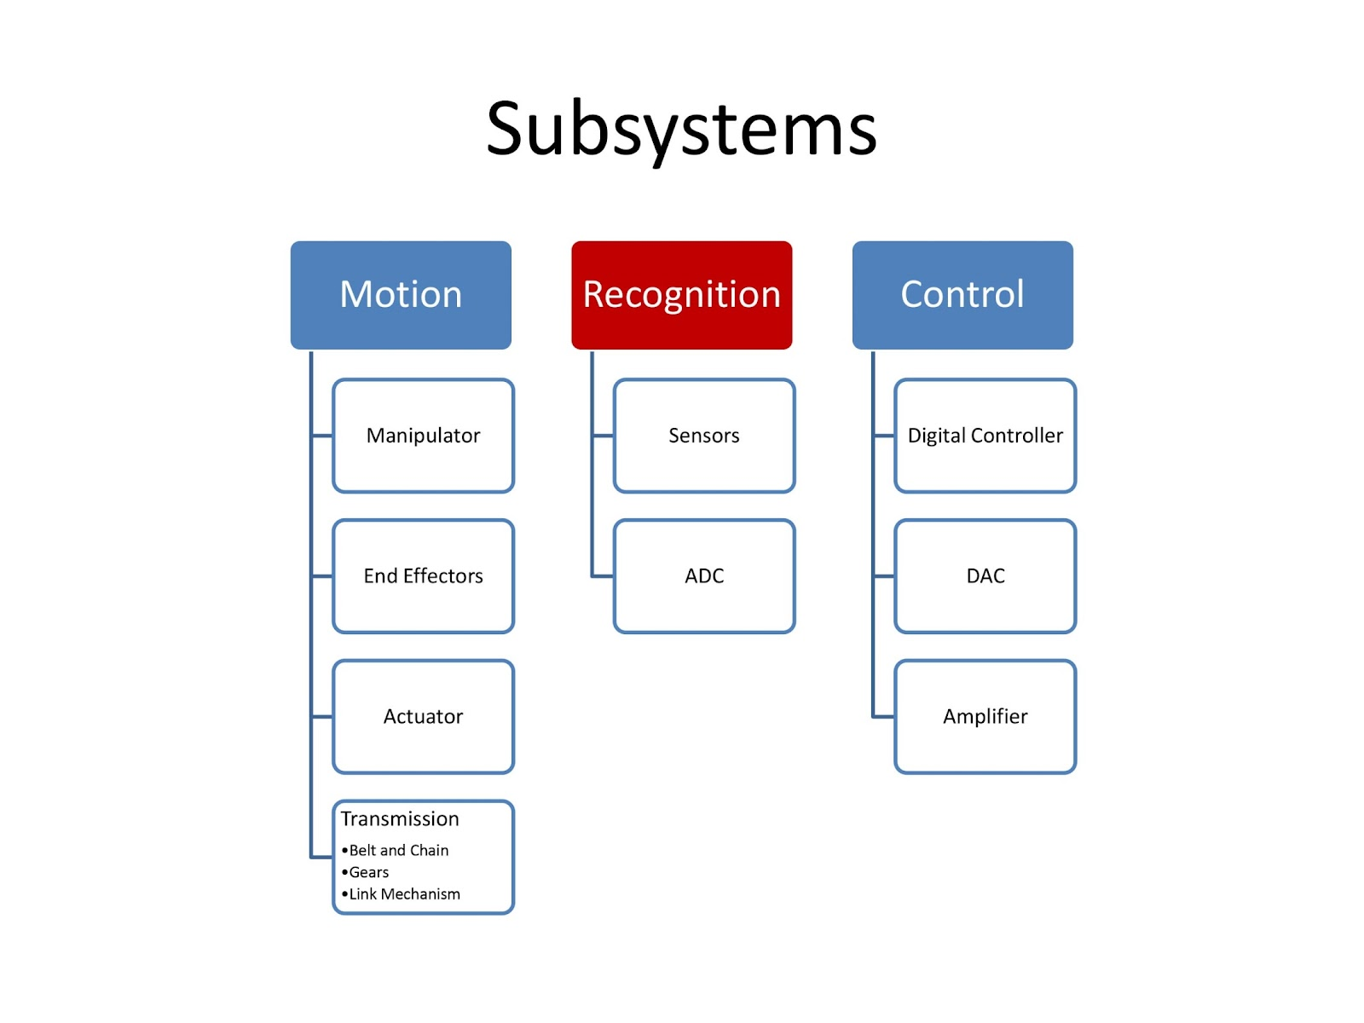

Slide 28
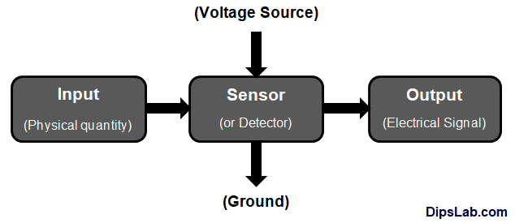
Sensor
A sensor is a device that detects or measures physical, chemical, or biological properties of the environment or a system and converts them into a signal that can be processed or analyzed.

Slide 29
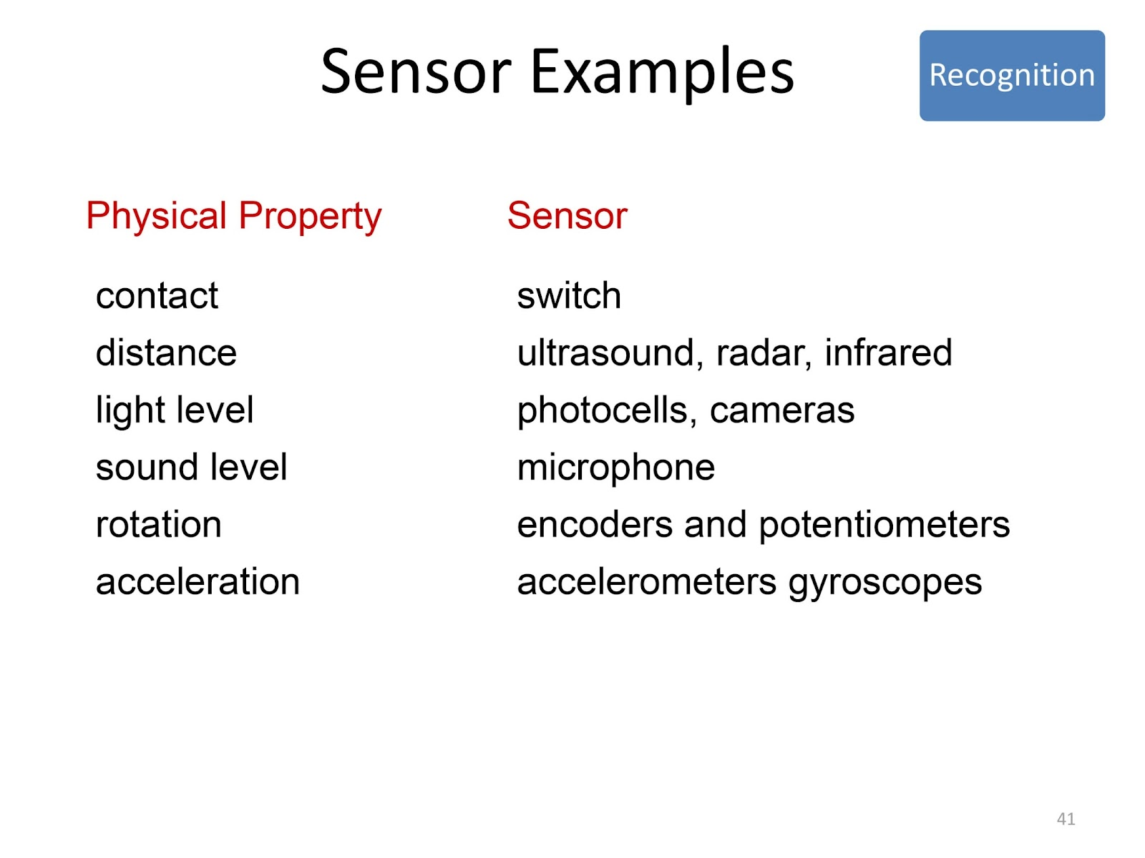

Slide 30
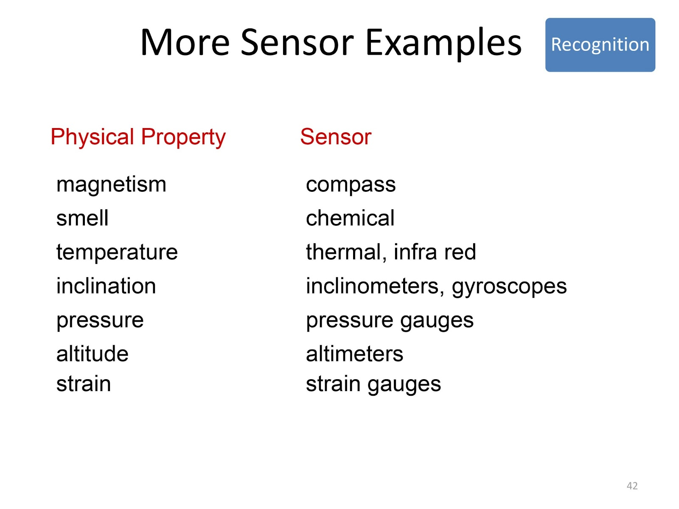

Slide 31
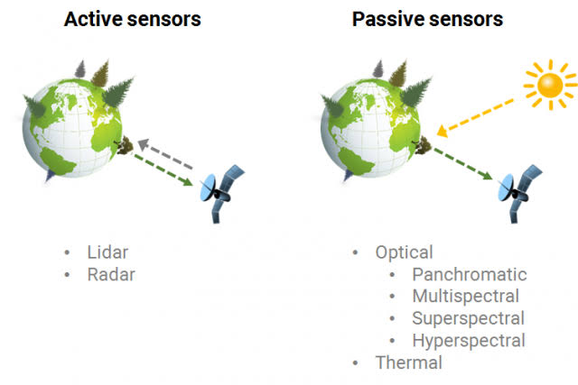

Slide 32
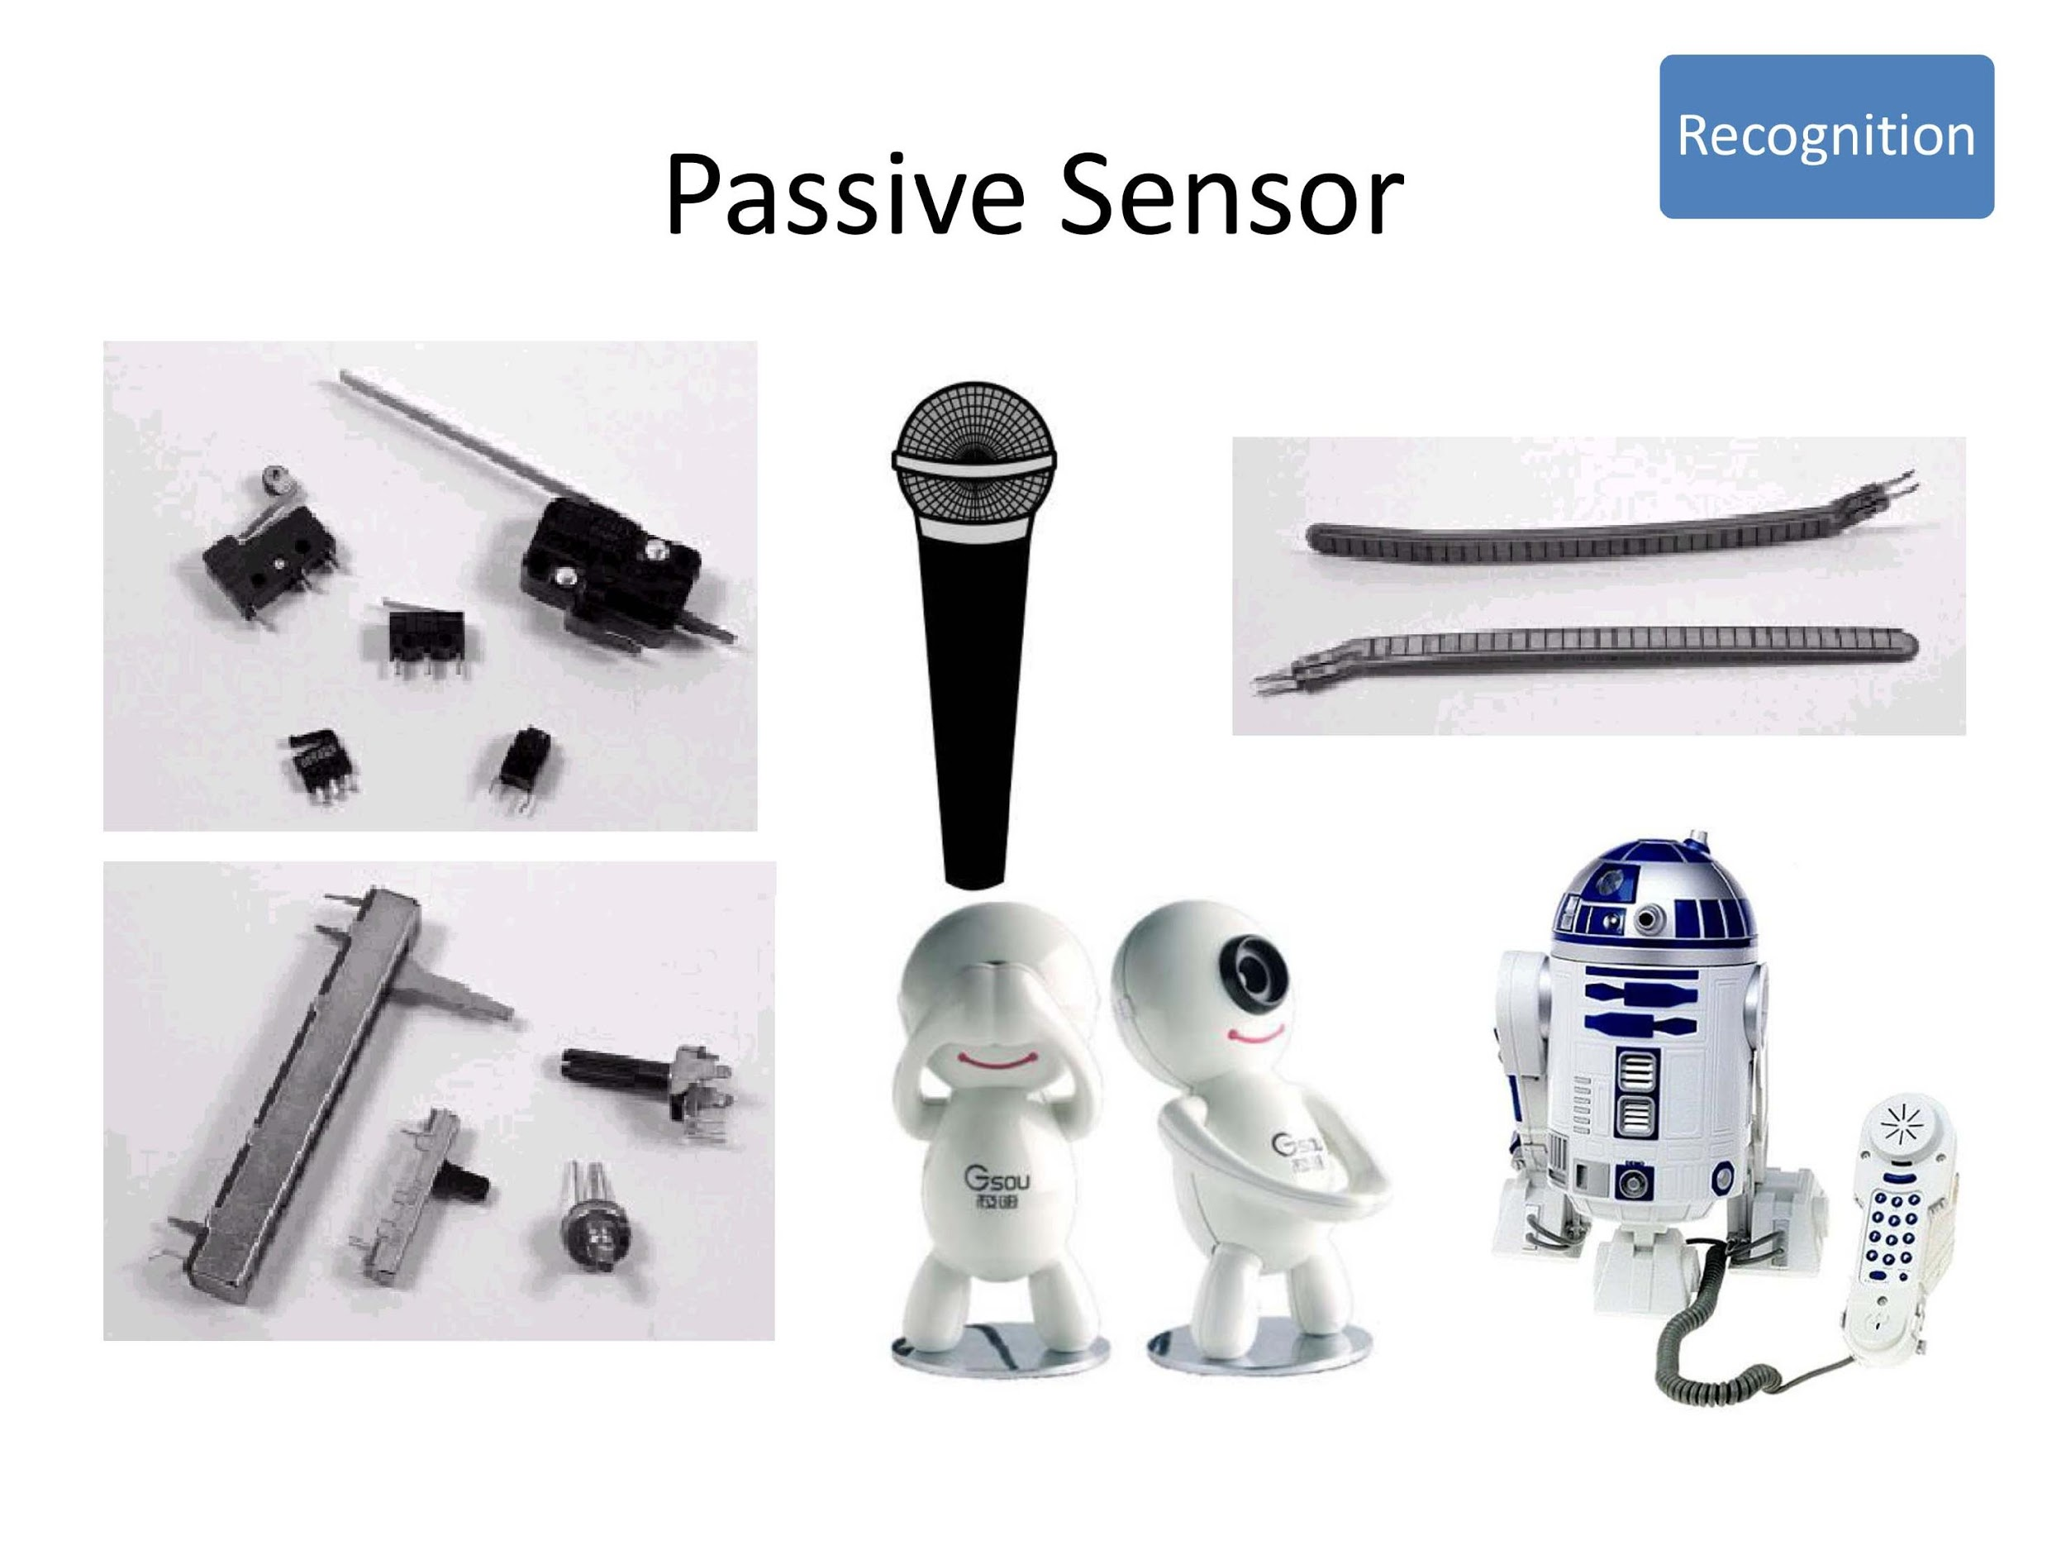

Slide 33
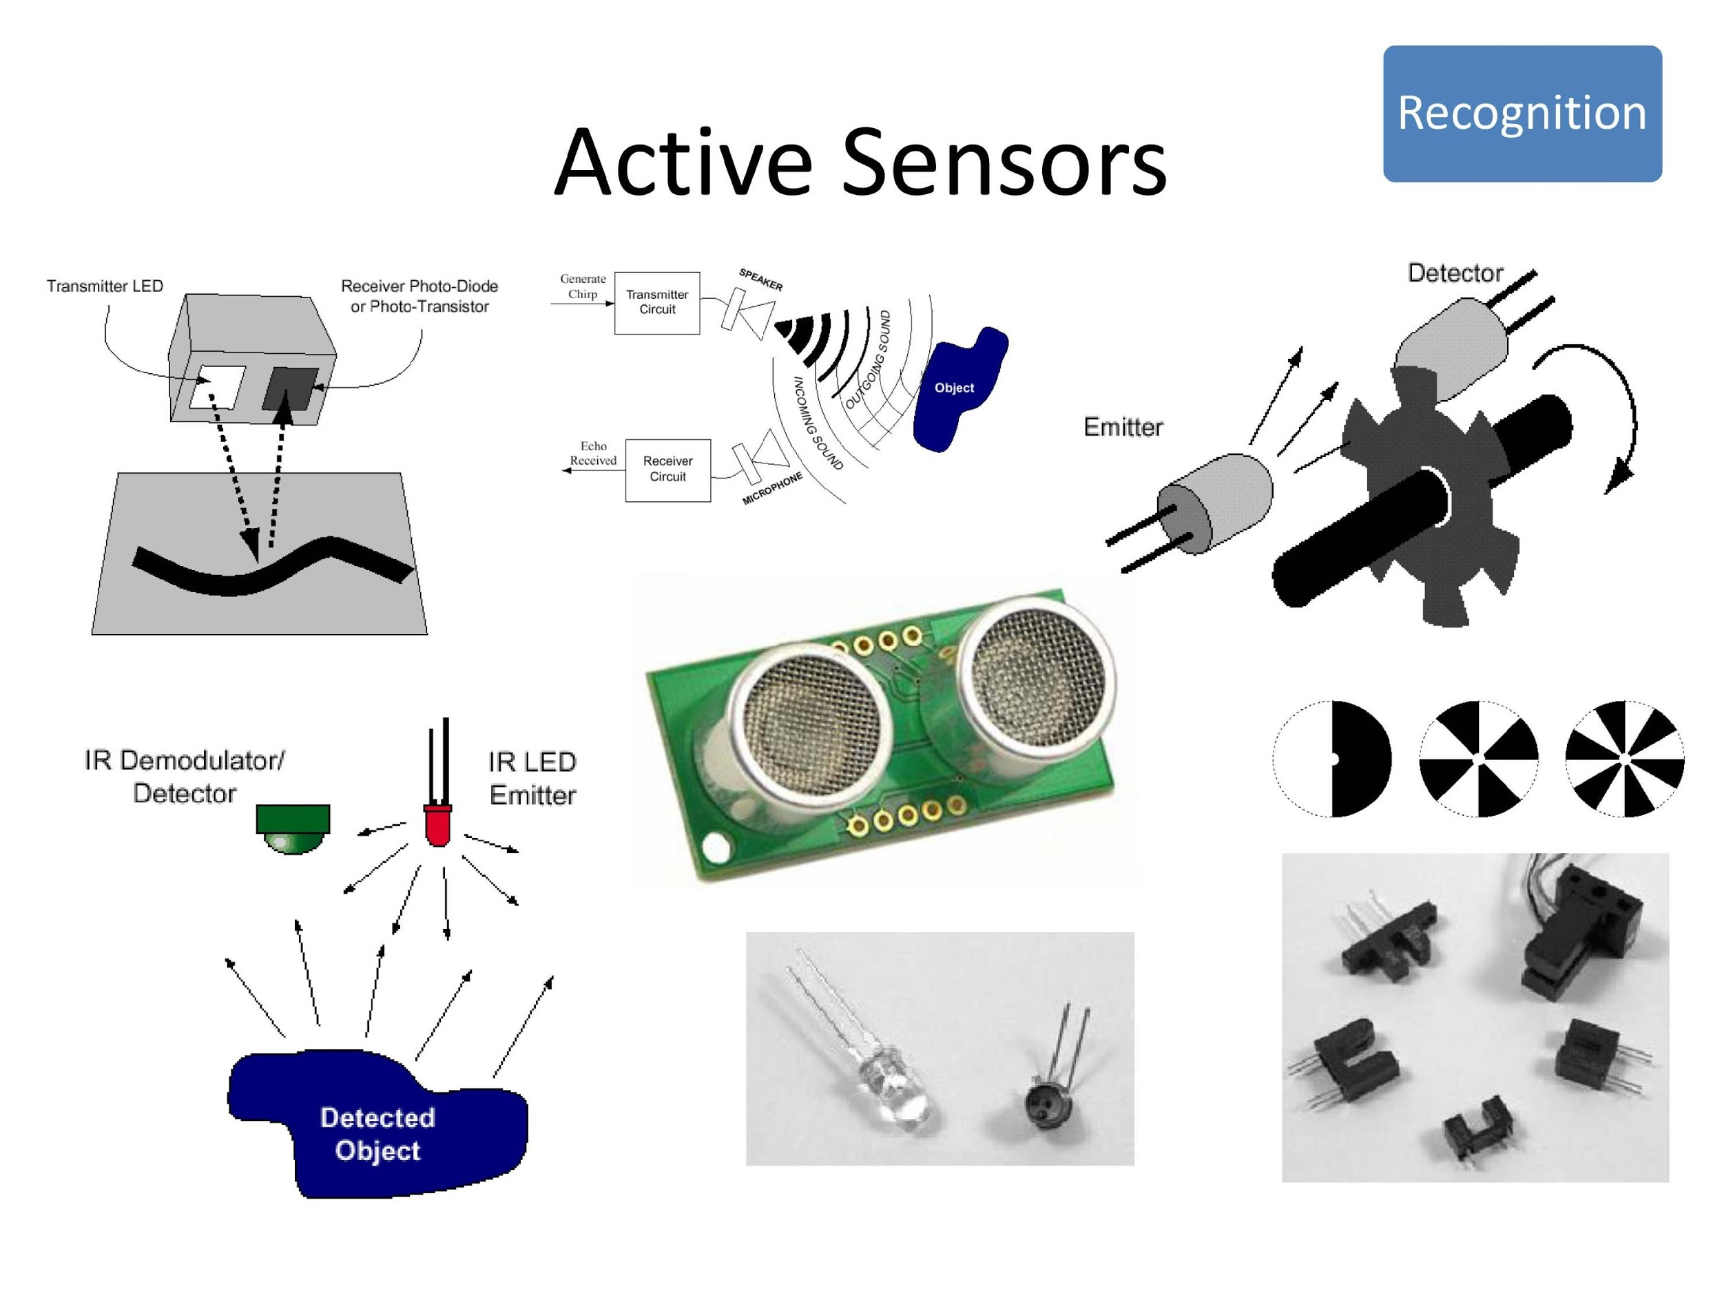

Slide 34
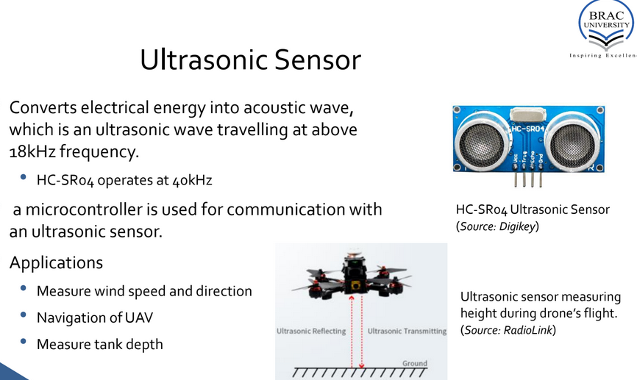

Slide 35
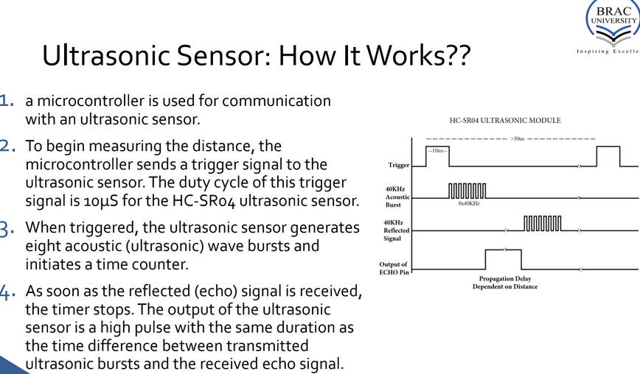

Slide 36
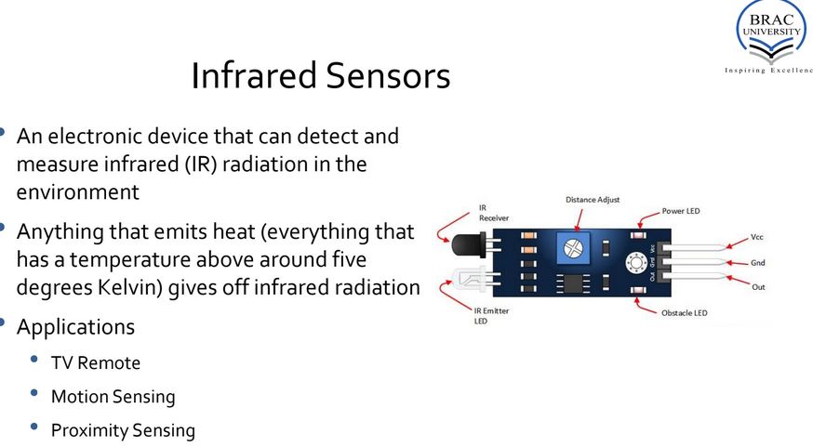

Slide 37
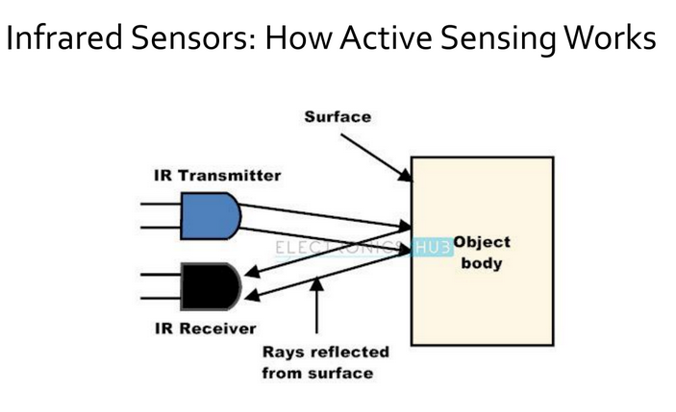

Slide 38
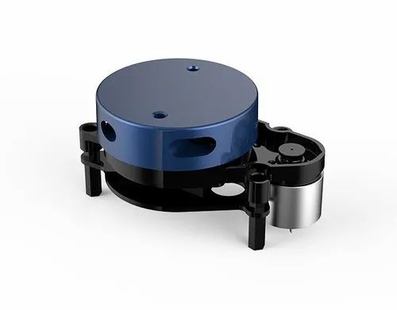
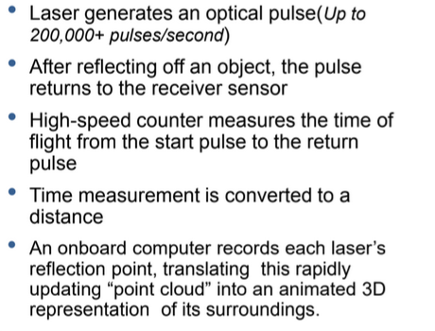
Lidar

Slide 39
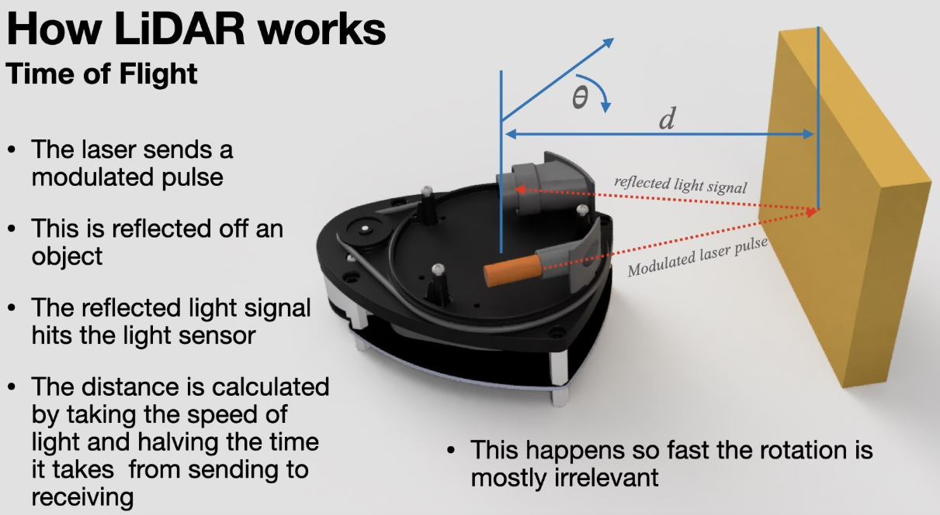

Slide 40
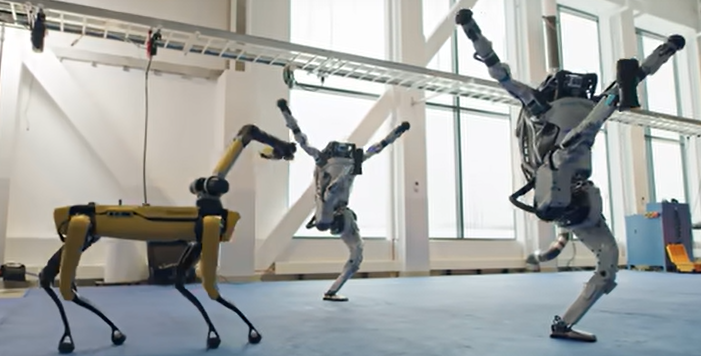
Let’s talk about a dream !
https://www.youtube.com/watch?v=fn3KWM1kuAw

Slide 41
Thank You

